Slide 1
Vision Transformer (ViT) in Depth and Comparison to CNN
BRYAN WONG
2021.12.3

Slide 2
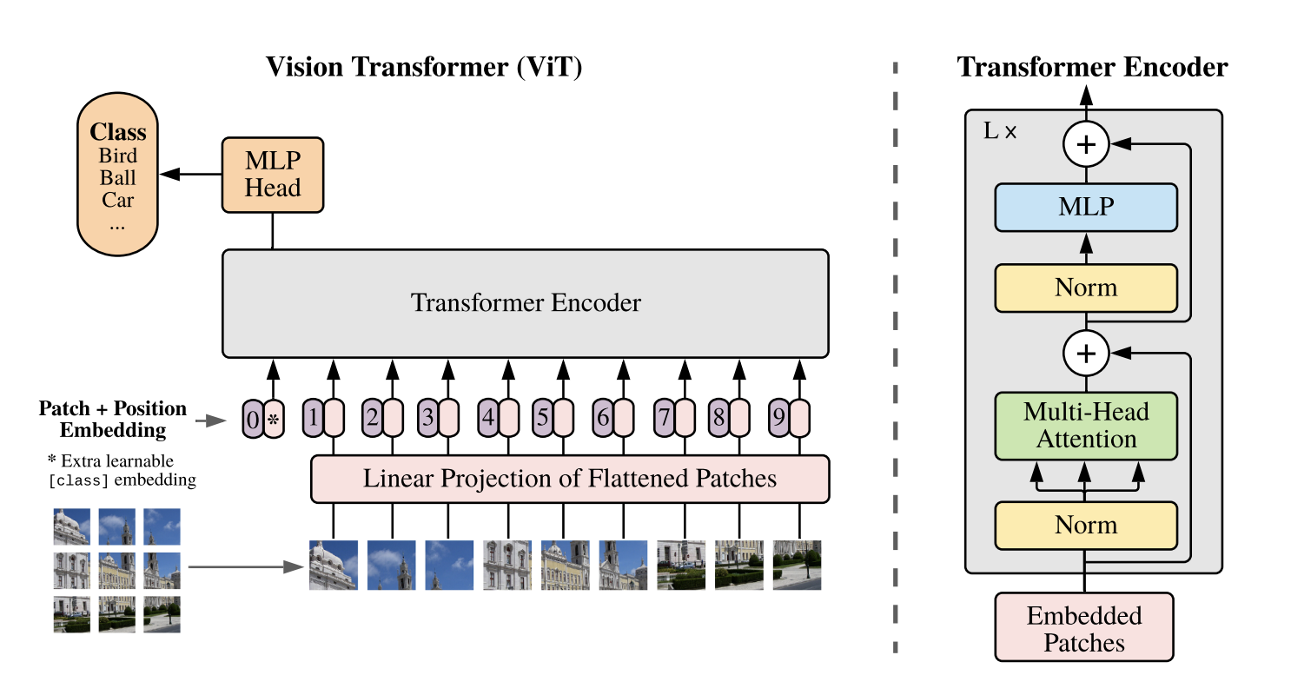
Dosovitskiy, Alexey et al. “An Image is Worth 16 x 16 Words:
Transformers for Image Recognition at Scale” (2020).

Slide 3
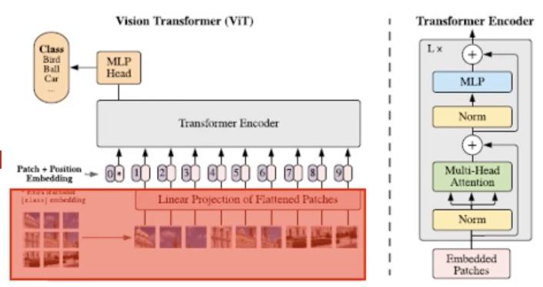
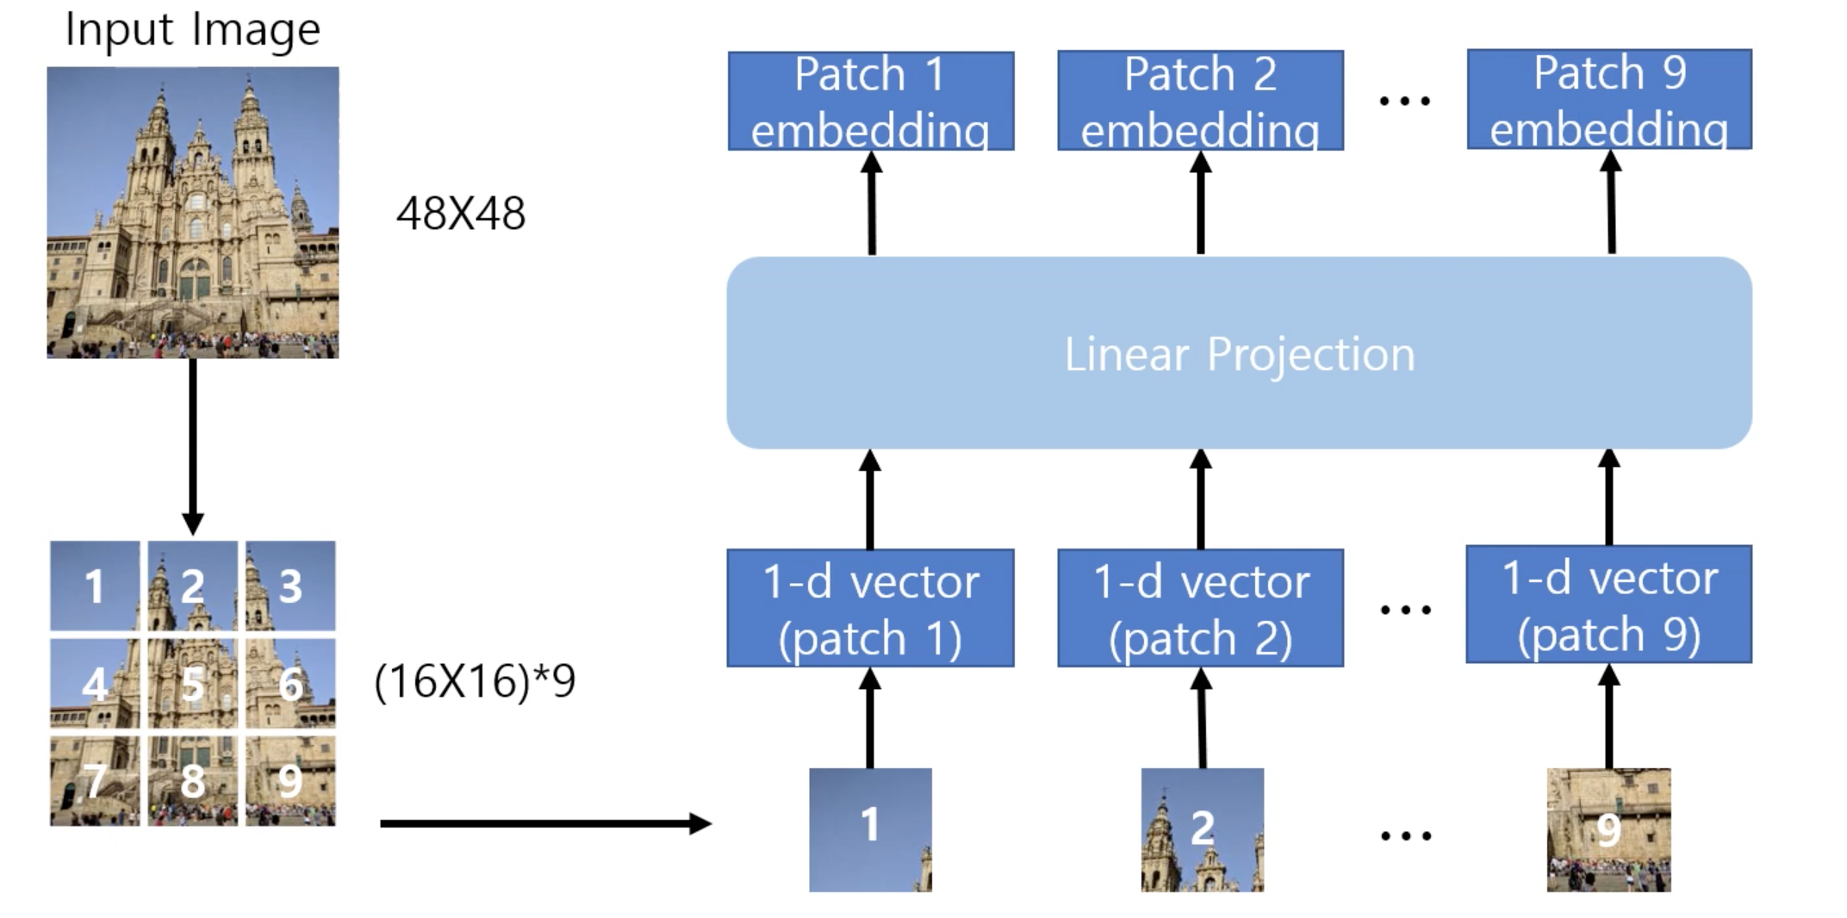
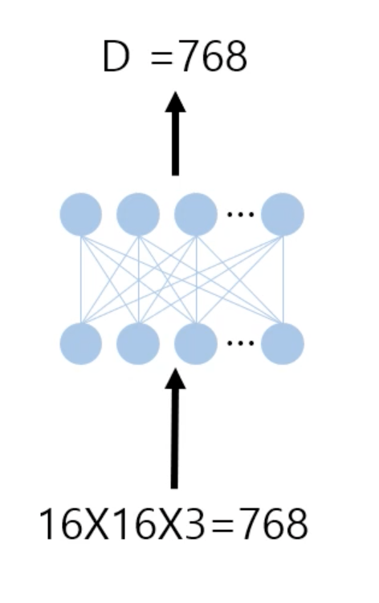

Slide 4
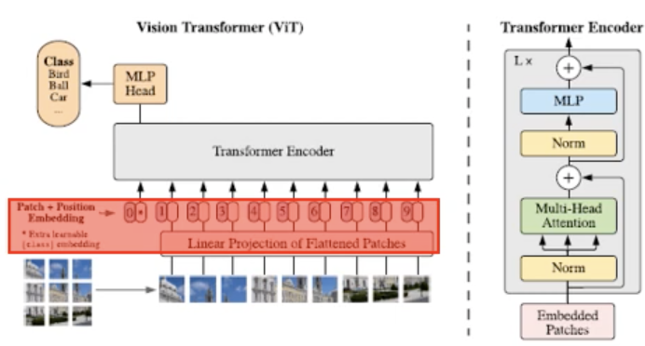
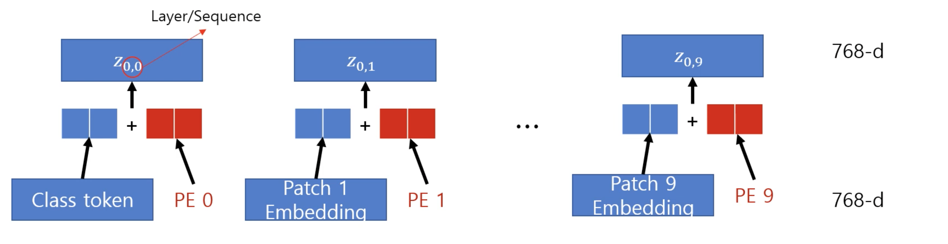
Classification token: token used for classification (BERT [CLS] token)
Positional Embedding (PE): location information of patch
Classification token and positional embedding are decided through learning
(Classification token, patch embedding) + positional embedding = Transformer Encoder

Slide 5
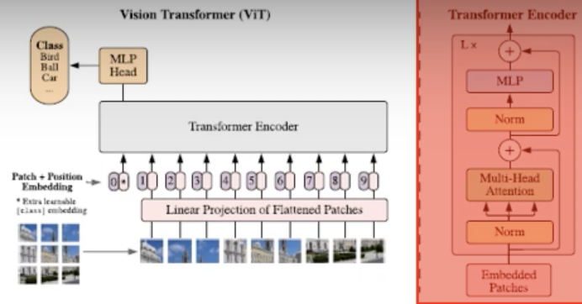
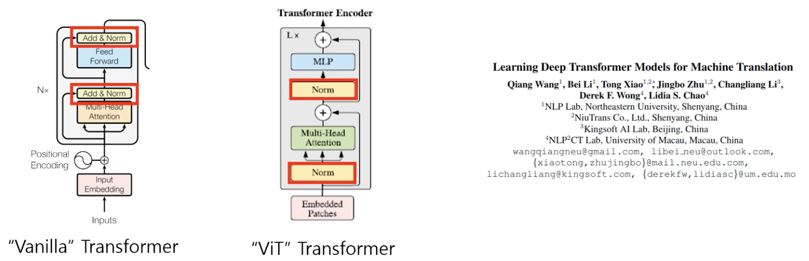
“Vanilla” Transformer Encoder vs “ViT” Transformer Encoder
The location of layer normalization plays an important role in Transformer learning (Wang et al.2019)
VIT applies a modified Transformer Encoder

Slide 6
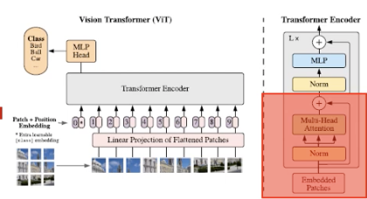
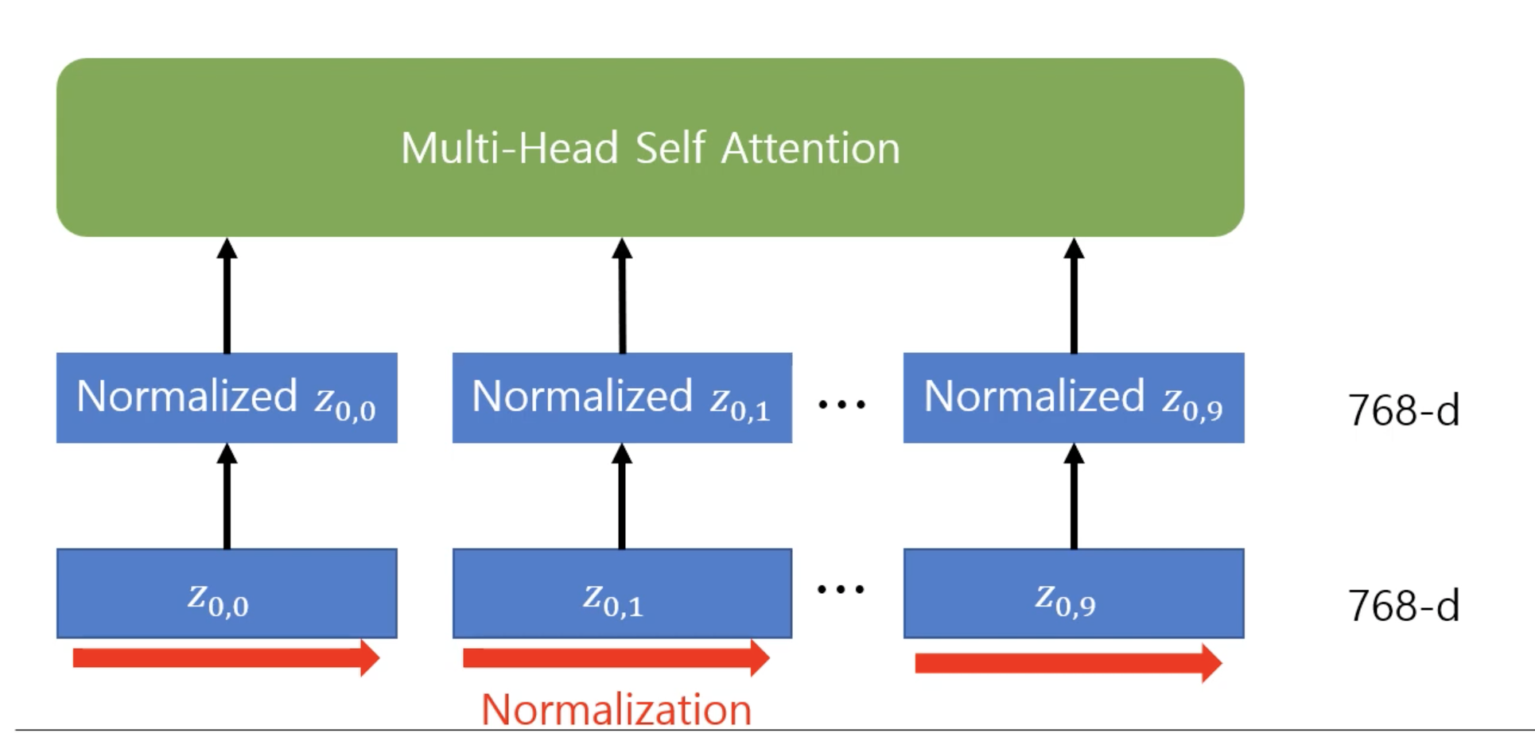
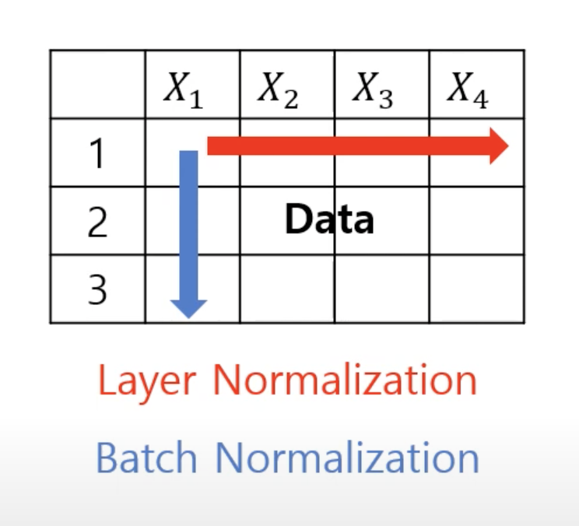
Transformer Encoder: Layer Normalization

Slide 7
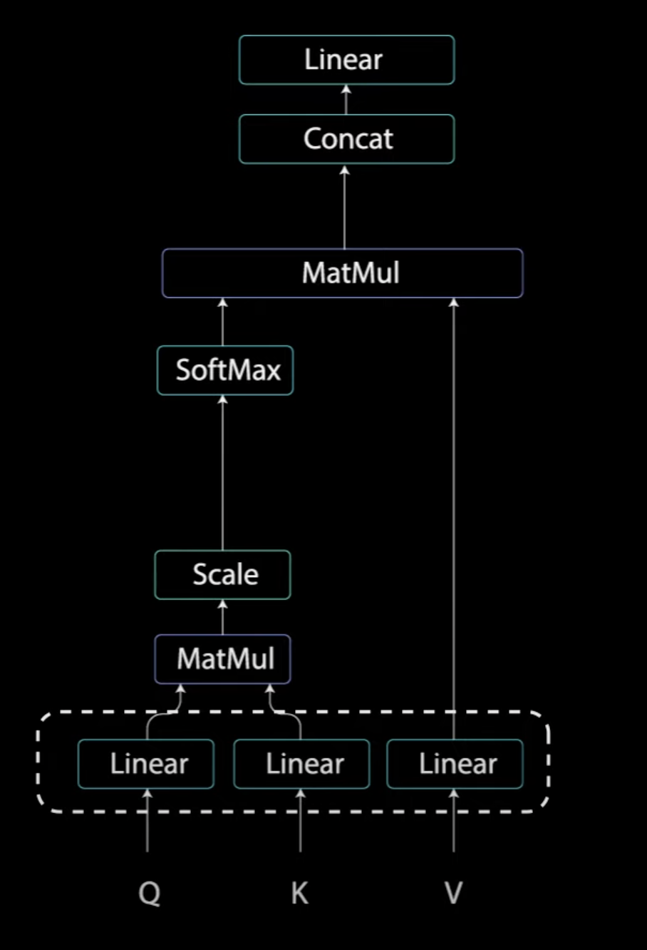
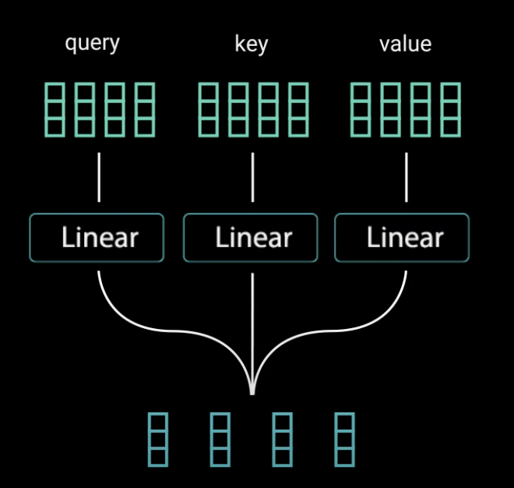
Self Attention
Wq, Wk, Wv (3 linear in picture):
parameters that need to be learned

Slide 8
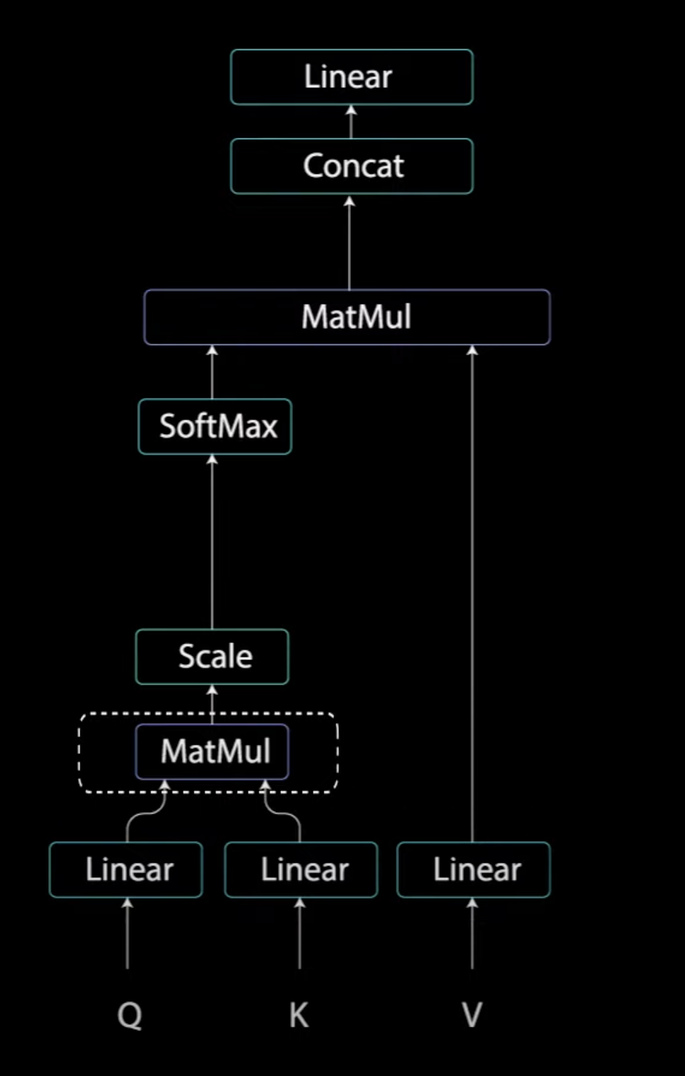
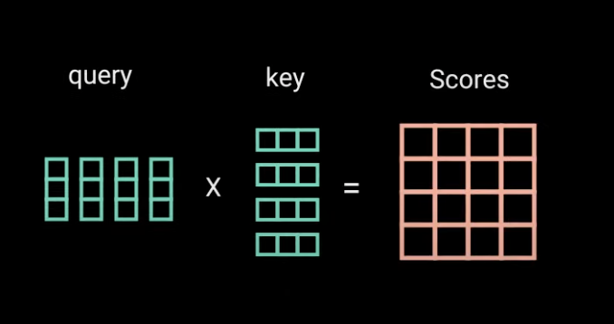
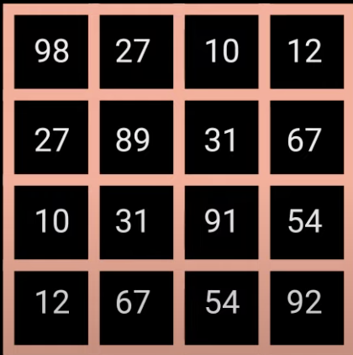
Self Attention

Slide 9
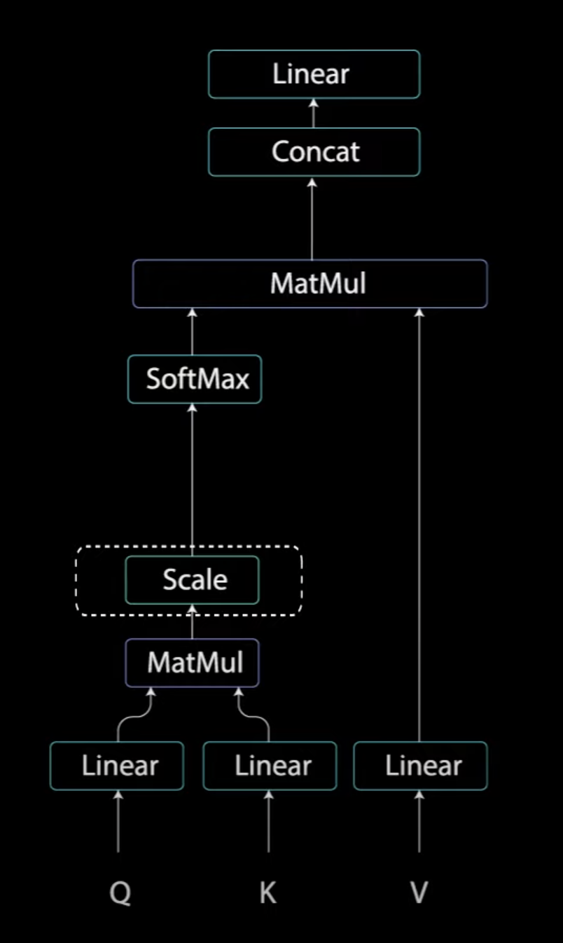
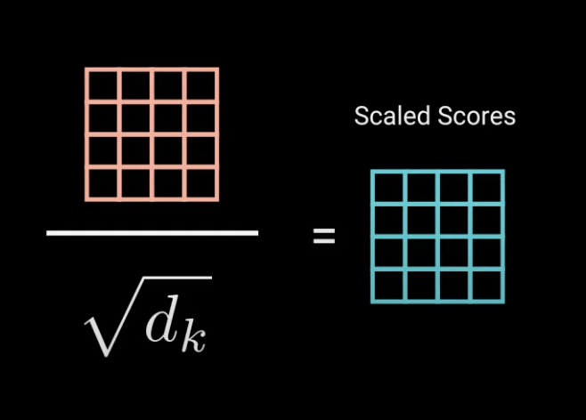
Self Attention

Slide 10
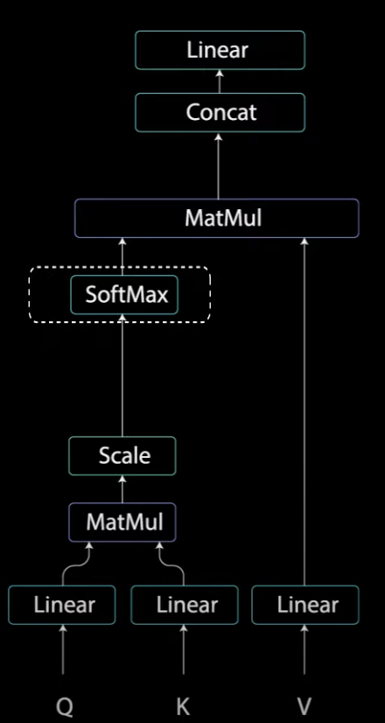
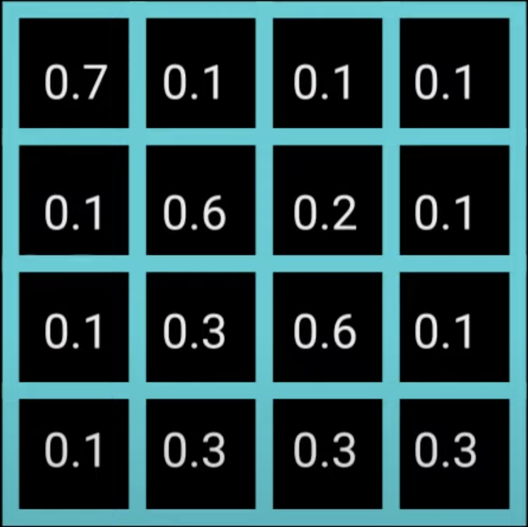
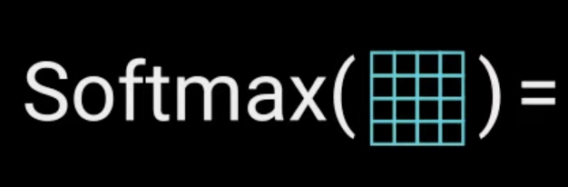
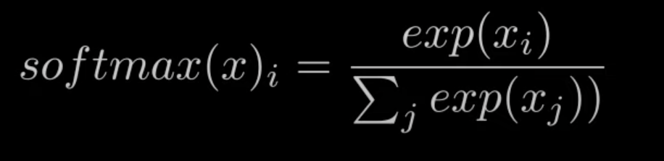
Self Attention

Slide 11
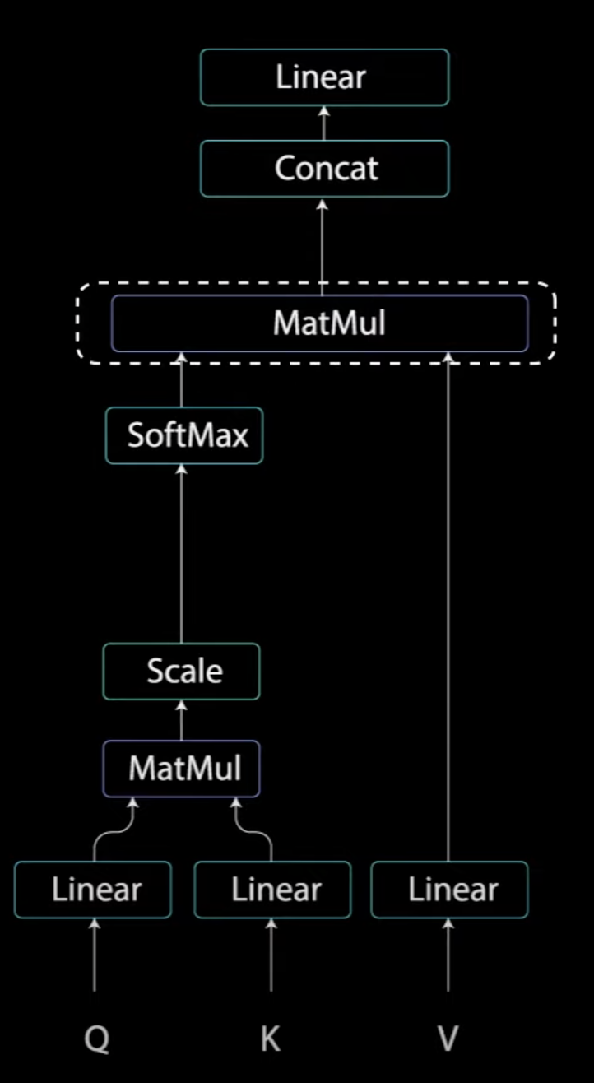
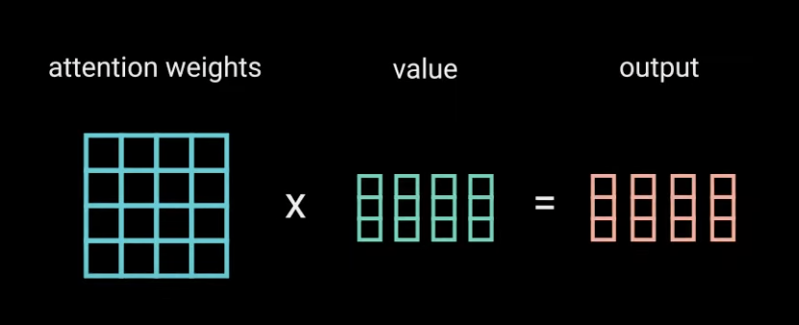
Self Attention

Slide 12
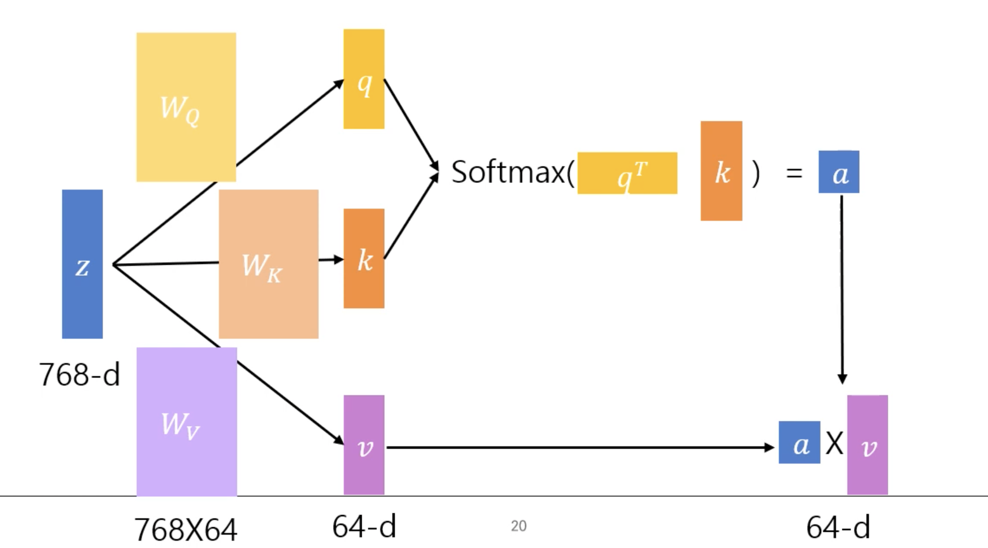
Self Attention Head
W matrix: parameters that need to be learned

Slide 13
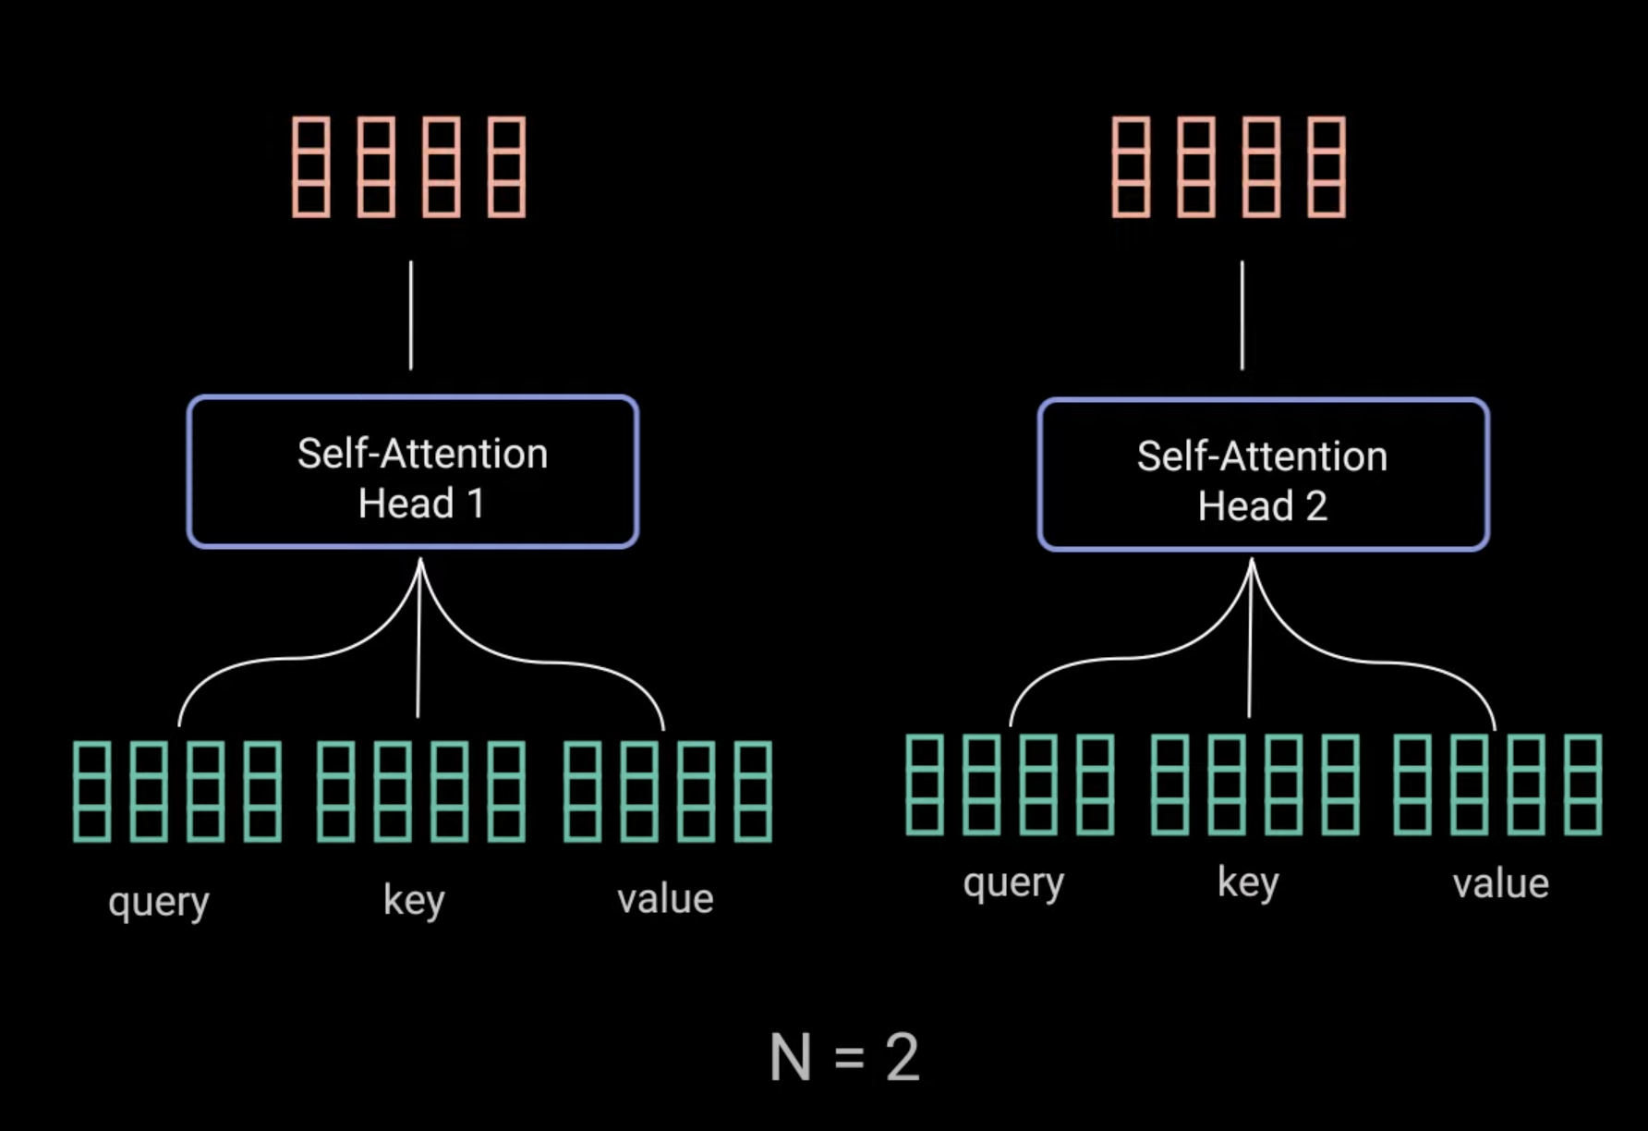
Multi Headed Attention

Slide 14
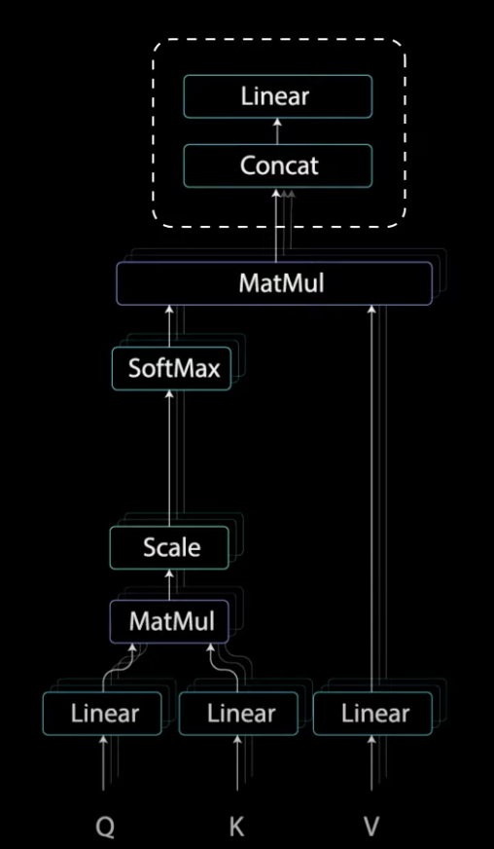
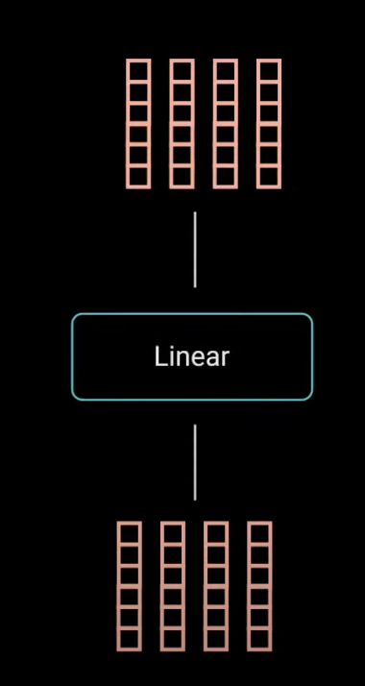
Multi Headed Attention

Slide 15
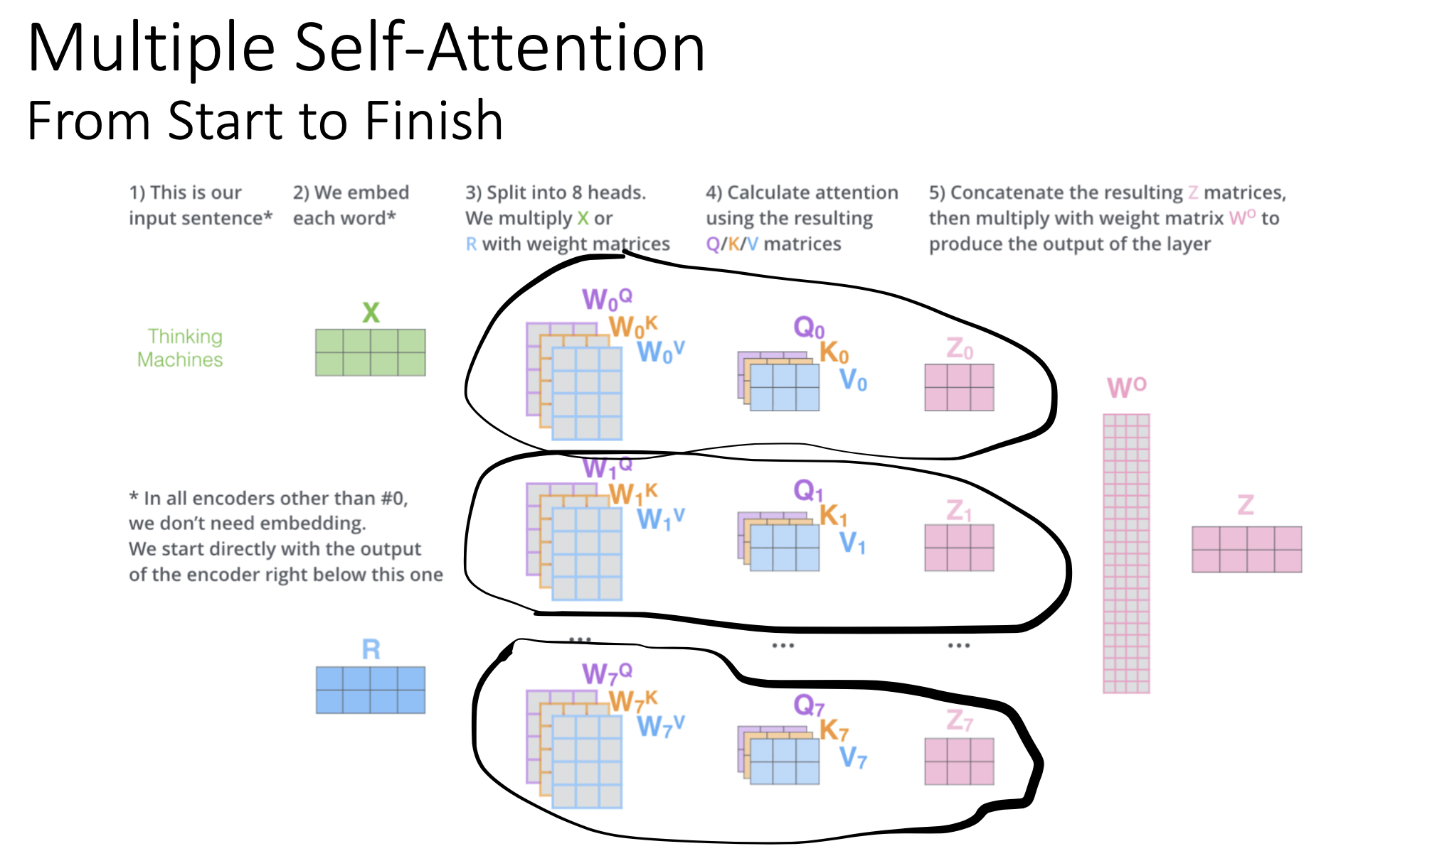

Slide 16
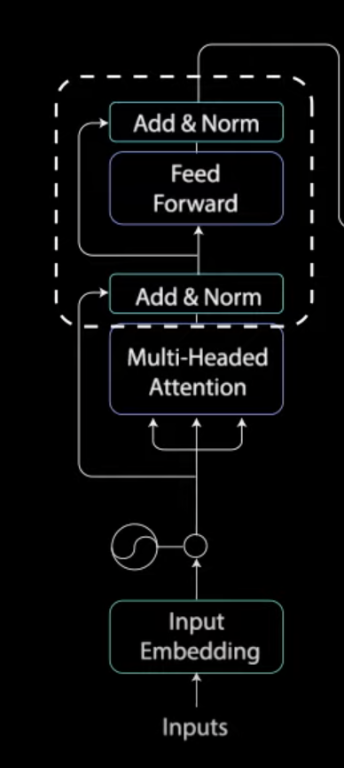
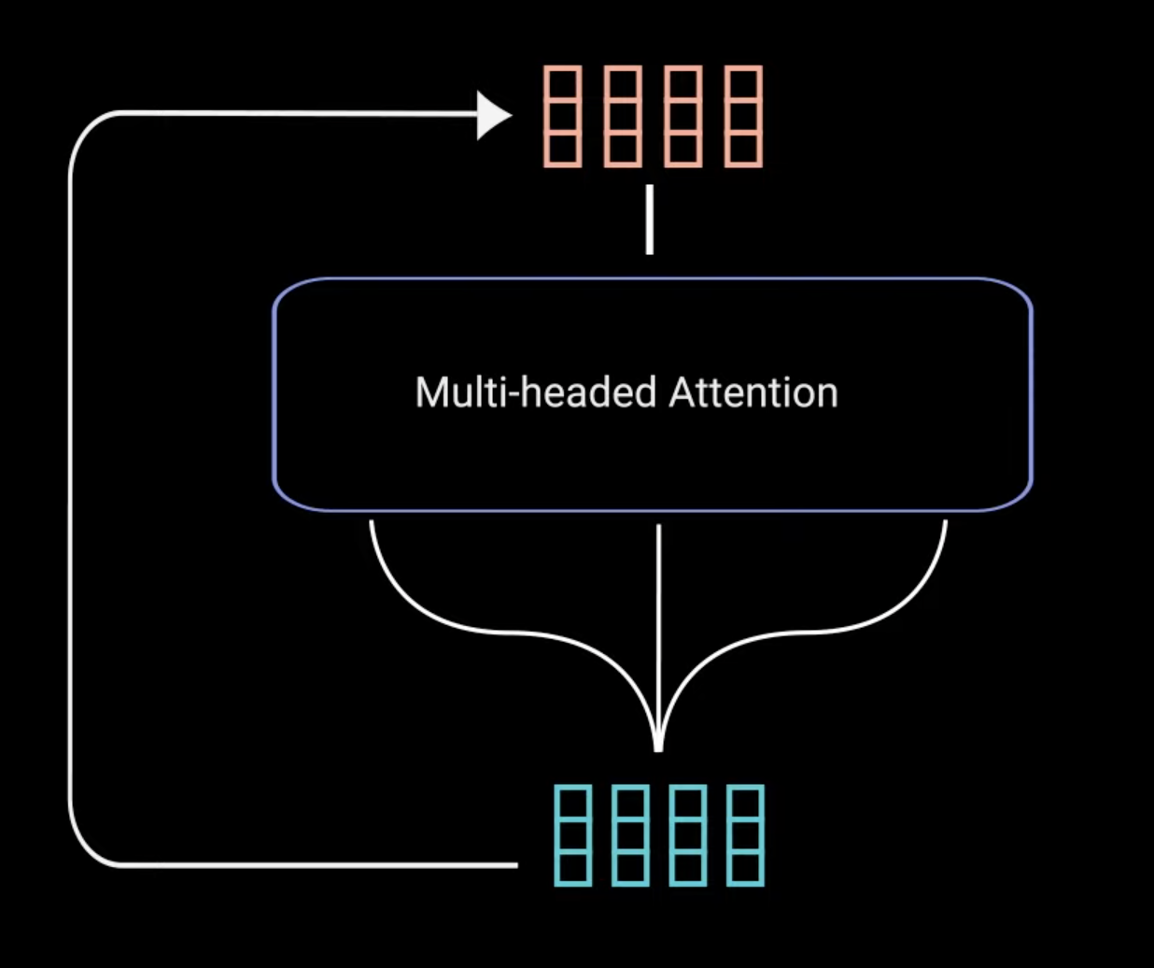
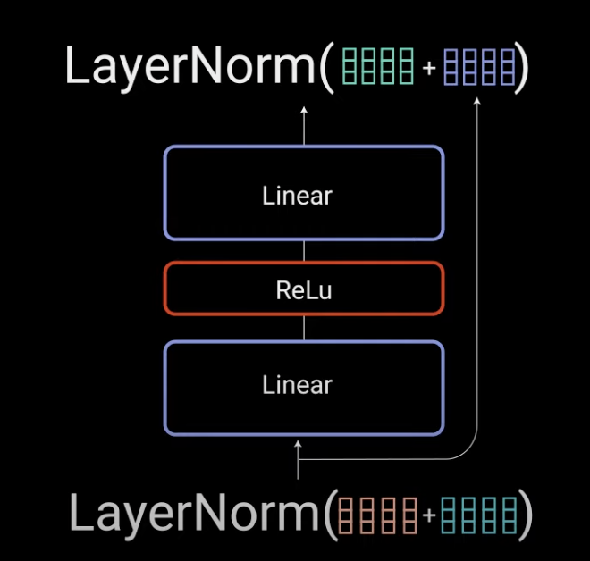
Residual Connection, Normalize, and Point Wise Feed Forward

Slide 17
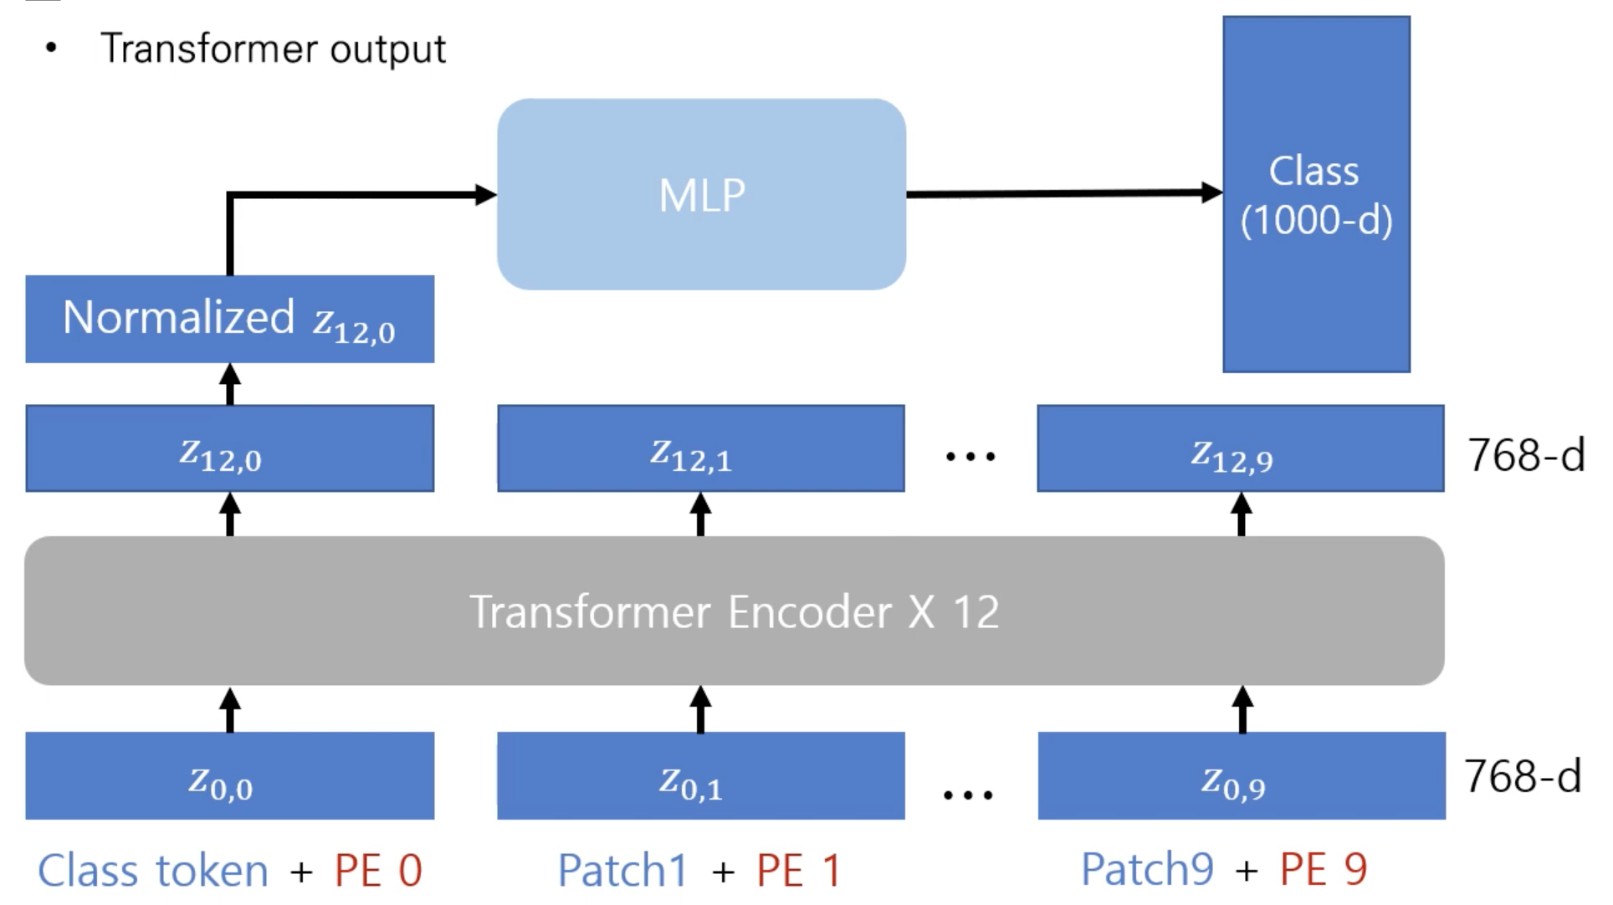
Transformer output

Slide 18
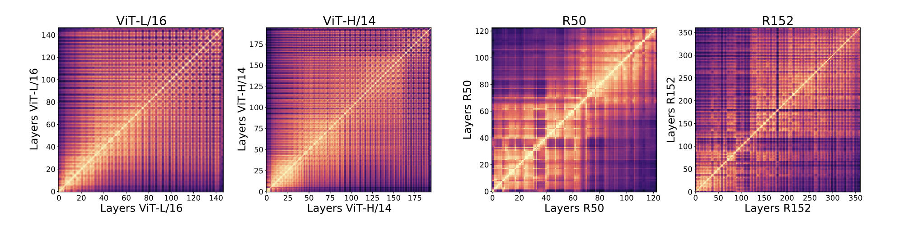
ViT has more similarity between the representations obtained in shallow and deep layers compared to CNNs
Raghu, Maithra et al. “Do Vision Transformers
See Like Convolutional Neural Networks?” (2021)

Slide 19
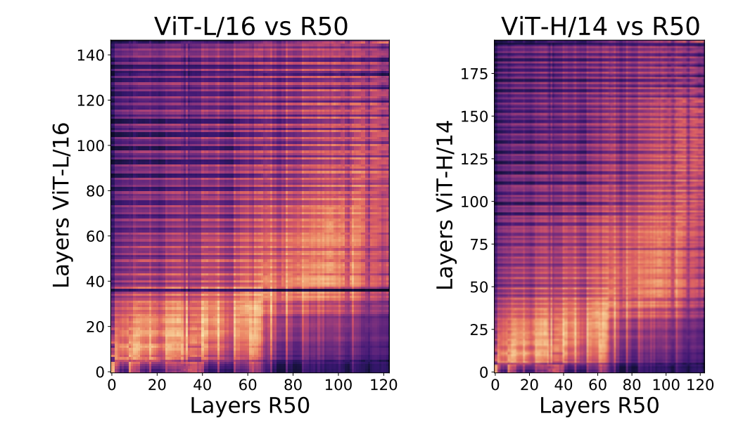
Raghu, Maithra et al. “Do Vision Transformers
See Like Convolutional Neural Networks?” (2021)

Slide 20
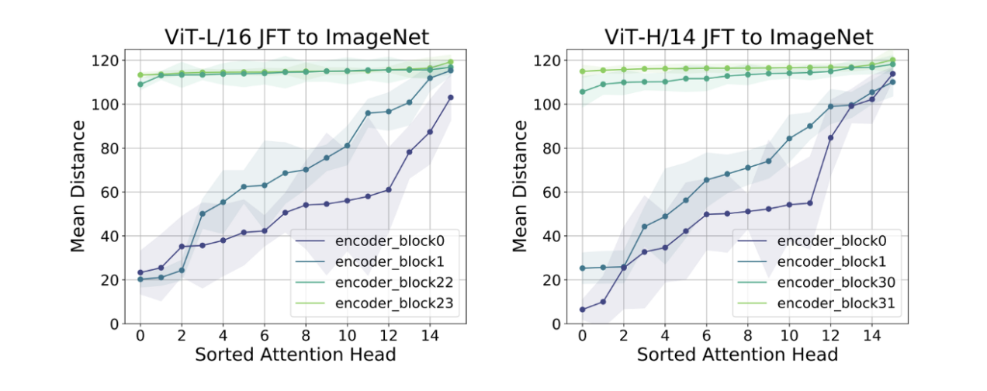
Unlike CNNs, ViT obtains the global representation from the shallow layers, but the local representation obtained from the shallow layers is also important
Raghu, Maithra et al. “Do Vision Transformers
See Like Convolutional Neural Networks?” (2021)

Slide 21
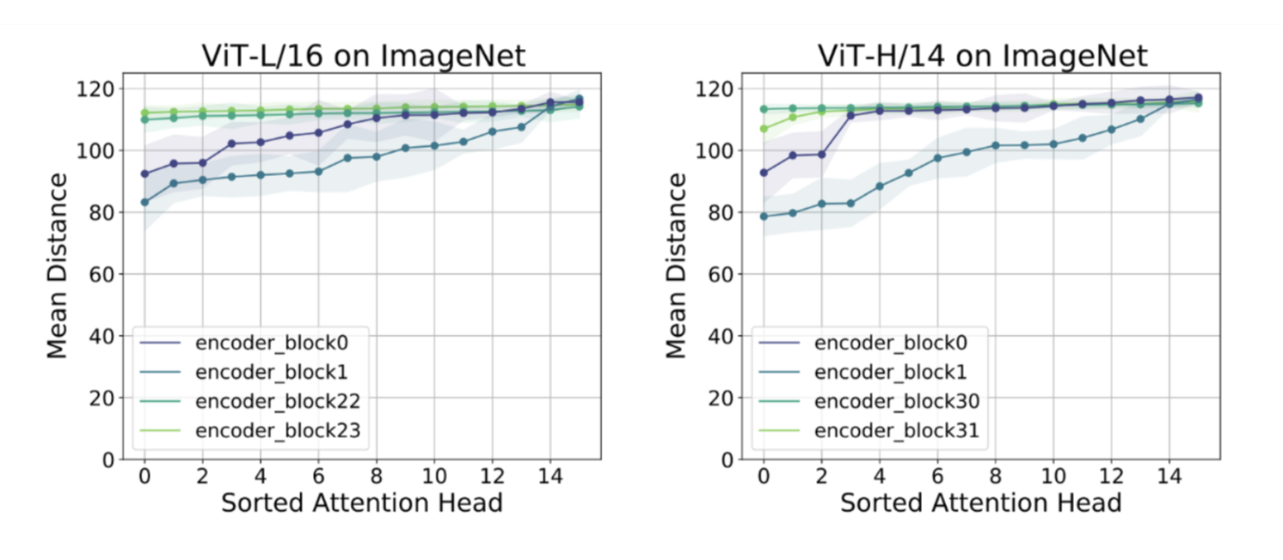
Less training data
Raghu, Maithra et al. “Do Vision Transformers
See Like Convolutional Neural Networks?” (2021)
“Transformers lack some of the inductive biases inherent to CNNs, such as translation equivariance and locality, and therefore do not generalize well when trained on insufficient amounts of data”
Dosovitskiy, Alexey et al. “An Image is Worth 16 x 16 Words: Transformers for Image Recognition at Scale” (2020).

Slide 22
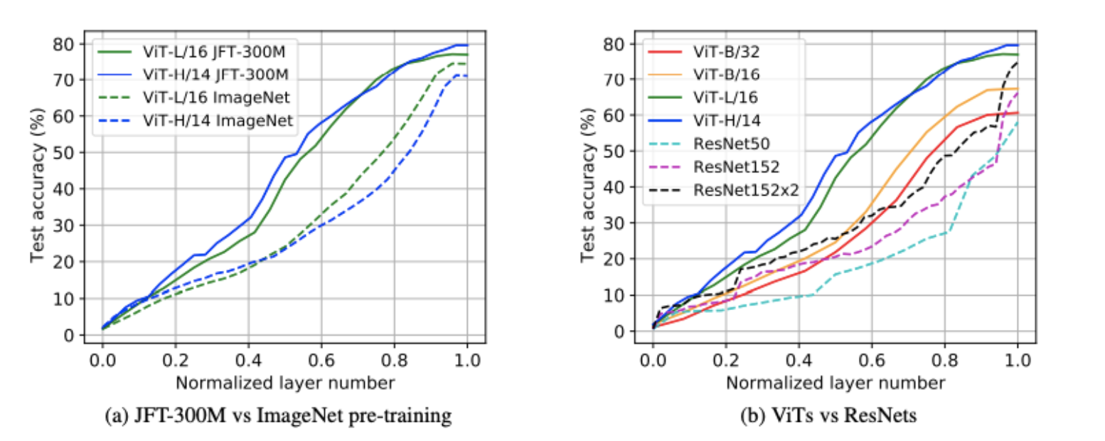
ViT can learn high-quality intermediate representations with large amounts of data
Raghu, Maithra et al. “Do Vision Transformers
See Like Convolutional Neural Networks?” (2021)

Slide 23
ViT vs CNN in Medical Images
Vision Transformers (ViT) require very large datasets to outperform CNN
CNN outperform ViT when trained from scratch (randomly initialized) given same amount of data
Both CNN and ViT benefit significantly from ImageNet initialization
When self-supervised + finetuning, ViT can outperform CNN
Matsoukas, Christos et al. “Is It Time to Replace CNNs with Transformers for Medical Images. “(2021)

Slide 24
ViT Base 16 vs Densenet201
Dataset:3000 images:
(85% train, 15% valid)1000 Dysplasia, (85% train, 15% valid) 1000 Malignant,
(85%train, 15% valid) 1000 Normal
Image augmentations: Resize((IMG_SIZE, IMG_SIZE)), Random Horizontal Flip(p=0.3), RandomVerticalFlip(p=0.3), RandomResizedCrop(IMG_SIZE), Normalize to Imagenet mean and std
Hyperparameters:
Batch size: 8
Optimizer: SGD – learning rate:2e-05 and momentum:0.9
Epochs: 30 | Early Stopping – Patience 3 epochs

Slide 25
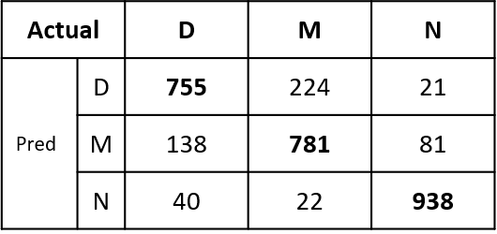
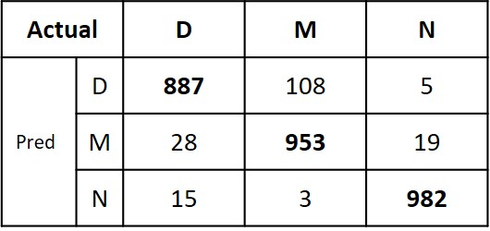
ViT Base 16 vs Densenet201
Densenet201 pretrained on Imagenet-1k ViT base 16 pretrained on
(1 million images, 1k classes) Imagenet-21k (14 million images, 21k classes)
Tested on another 3000 images Tested on another 3000 images
(Accuracy: 82.47%) (Accuracy: 94.06%)
75.5%
88.7%
78.1%
95.3%
93.8%
98.2%

Slide 26


